Slide 1
Continuity testing – ring final circuit conductors
PowerPoint presentation
Unit 304: Electrical Installations: inspection, testing and commissioning

Slide 2
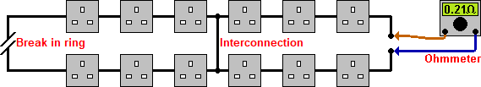
Continuity of ring final circuit conductors
The initial purpose of the test is to prove that each conductor of the ring actually forms a ring and is continuous.
The test also determines if the ring has been interconnected to form a figure‑of‑eight circuit that could have breaks in it but gives the impression of being a complete ring.

Slide 3
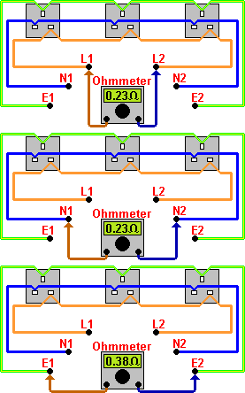
Continuity of ring final circuit conductors
Step 1

Slide 4
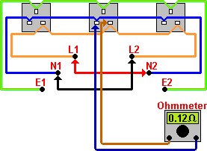
Continuity of ring final circuit conductors
Step 2

Slide 5
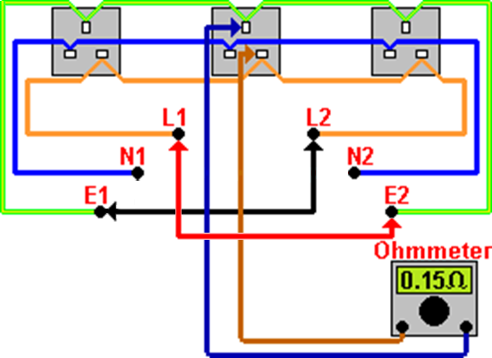
Continuity of ring final circuit conductors
Step 3

Slide 6
Continuity of ring final circuit conductors
As a guide:

Slide 7
Any questions?

